Slide 1
A* Algorithm Task
Explain how the A* algorithm can be used in the design of a game. It must be clear how the algorithm is applied.
Remember to annotate your slide

Slide 2
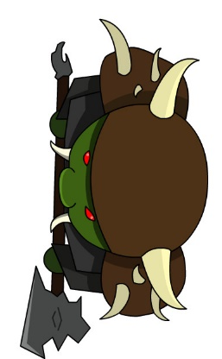

Game Design behaviour tree task
Your task is to demonstrate how you could apply a behaviour tree within a game.
You will need to demonstrate the in game function along with what behaviour tree is being applied. Finally you will provide a design of your behaviour tree to show how it has been applied to the game.

